Slide 1
Fundamentals of Python: First Programs Second Edition
Chapter 9
Design with Classes

Slide 2
Objectives (1 of 2)
9.1 Determine the attributes and behavior of a class of objects required by a program
9.2 List the methods, including their parameters and return types, that realize the behavior of a class of objects
9.3 Choose the appropriate data structures to represent the attributes of a class of objects
9.4 Define a constructor, instance variables, and methods for a class of objects

Slide 3
Objectives (2 of 2)
9.5 Recognize the need for a class variable
9.6 Define a method that returns the string representation of an object
9.7 Define methods for object equality and comparisons
9.8 Exploit inheritance and polymorphism when developing classes
9.9 Transfer objects to and from files

Slide 4
Objects & Classes
In an object-oriented programming language, you create objects in your programs.
In software, an object has two capabilities:
An object can store multiple pieces of data.
An object can perform operations.
The data stored in an object are commonly called attributes or fields.
The operations that an object can perform are called methods.

Slide 5
Objects & Classes
A primitive data type (like int, float, char, etc.) can only store data, as it has no other built-in capabilities.
We can create our own complex data types by creating a new class with variables and methods in it. (The variables are instance variables.)
Then we declare objects with that class as their data type

Slide 6
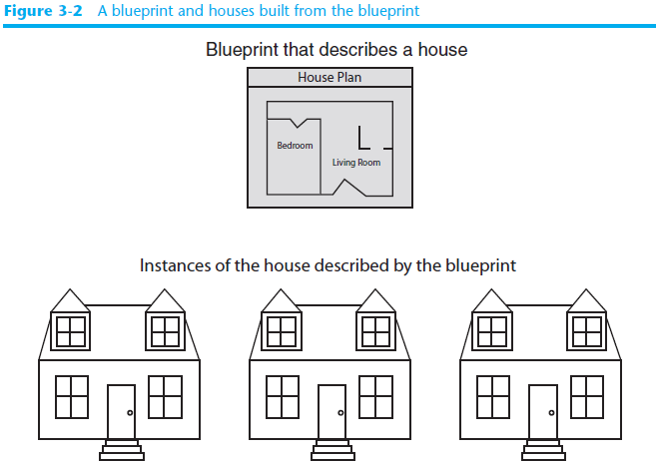
Getting Inside Objects and Classes
Programmers who use objects and classes must know:
The interface that can be used with a class
The state of an object
How to instantiate a class to obtain an object
Class definition is like a blueprint for each of the objects of that class and contains:
Definitions of all of the methods that its objects use
The instance variables that define the state of an object

Slide 7
Getting Inside Objects and Classes
Each instance (object) of a class contains different data.
The objects all share the same design.
Each object has all of the attributes (which are variables) and methods that were defined in the class.
Classes are defined to represent a single concept or service.

Slide 8
Getting Inside Objects and Classes
Student Class
name
major
GPA
totalCreditHours totalGradePoints
_____________
getName()
getGPA()
calcGPA()
alice
peter
sam
Object1
name: Alice Needles
major: History
GPA: 3.00
Credit hrs: 10
Grade pts: 30
_____________
getName()
getGPA()
calcGPA()
Object2
name: Peter Hughes
major: Math
GPA: 3.50
Credit hrs: 10
Grade pts: 35
_____________
getName()
getGPA()
calcGPA()
Object3
name: Sam Dooley
major: English
GPA: 2.47
Credit hrs: 15
Grade pts: 37
_____________
getName()
getGPA()
calcGPA()

Slide 9
A First Example: The Student Class
Student Method | What It Does
s = Student(name, creditHours, gradepoints) | Returns a Student object with the given name, grade points and credit hours. Also, computes the GPA.
s.getName() | Returns the student’s name
s.getGPA() | Returns the student’s GPA
s.addPointsAndHours (gPoints, cHours): | Adds the input number of grade points and credit hours to the student attributes and recomputes the GPA
s. calcGPA() | Calculates the student’s current GPA
s.__str()__ | Same as str(s). Returns a string representation of the student’s information

Slide 10
A First Example: The Student Class
"""
File: student.py
Resources to manage a student's name and test scores.
"""
class Student(object):
"""Represents a student."""
def __init__(self, nm, cHours, gPoints):
"""Set instance variables equal to input values."""
self.name = nm
self.gradePoints = gPoints
self.creditHours = cHours
self.gpa = self.calcGPA()
def getName(self):
"""Returns the student's name."""
return self.name
def getGPA(self):
"""Returns the student’s GPA."""
return self.gpa
def addPointsAndHours(self, gPoints, cHours):
"""Resets the ith score, counting from 1."""
self.gradePoints += gPoints
self.creditHours += cHours
self.gpa = self.calcGPA()
def calcGPA(self):
"""Calculates current GPA"""
if (self.creditHours == 0):
return 0
else:
return self.gradePoints / self.creditHours
def __str__(self):
"""Returns the string representation of the student."""
return "Name: " + self.name + "\nScores: " + \
" ".join(map(str, self.scores))
# ******************************************
def main():
"""A simple test."""
ken = Student("Ken Harris", 8, 28)
print(student)
ken. addPointsAndHours(7,21)
print(student)
if __name__ == "__main__":
main()

Slide 11
A First Example: The Student Class
Syntax of a simple class definition:
class <class name>(<parent class name>):
<method definition−1>
…
<method definition−n>
Class name is a Python identifier
Typically capitalized
Python classes are organized in a tree-like class hierarchy
At the top, or root, of this tree is the object class
Some terminology: subclass, parent class

Slide 12
Docstrings
Docstrings can appear at three levels:
Module
Just after class header
To describe its purpose
After each method header
Serve same role as they do for function definitions
help(Student) prints the documentation for the class and all of its methods

Slide 13
Method Definitions
Method definitions are indented below class header
Syntax of method definitions similar to functions
Can have required and/or default arguments, return values, create/use temporary variables
Returns None when no return statement is used
Each method definition must include a first parameter named self
Example: ken.addPointsAndHours(30, 8)
The parameter self is not listed in the ( ) when you call the method, but it is implied by the ken. at the beginning of the call.
If you call a method from another method inside the class, it is formatted self.methodName (Ex – self.calcGPA() in the __init__ method)

Slide 14
The _init_ Method and Instance Variables
Most classes include the __init__ method (which is the constructor)
def __init__(self, name, number):
"""All scores are initially 0."""
self.name = name
self.scores = []
for count in range(number):
self.scores.append(0)
Runs automatically when user instantiates the class
Example: s = Student("Juan Linares", 5, 18)
Instance variables represent object attributes
Serve as storage for object state
Scope is the entire class definition
(Remember that scope means which methods are allowed to use the variable.)

Slide 15
The _str_ Method
Classes usually include an __str__ method
Builds and returns a string representation of an object’s state
def __str__(self) :
"""Returns the string representation of the student."""
return "Name: " + self.name + "\nGPA: " + str(self.gpa)
When str function is called with an object, that object’s __str__ method is automatically invoked
Also, when the statement print(objectName) is called in main, it will call __str__ and print the string it returns

Slide 16
Accessors and Mutators
Methods that allow a user to observe but not change the state of an object are called accessors
Methods that allow a user to modify an object’s state are called mutators
def addPointsAndHours(self, gPoints, cHours):
"""Resets the ith score, counting from 1."""
self.gradePoints += gPoints
self.creditHours += cHours
self.gpa = self.calcGPA()
Tip: if there’s no need to modify an attribute (e.g., a student’s name), do not include a method to do that

Slide 17
The Lifetime of Objects
The lifetime of an object’s instance variables is the lifetime of that object
An object becomes a candidate for the graveyard when it can no longer be referenced
But the Python virtual machine will eventually recycle its storage during a process called garbage collection

Slide 18
Rules of Thumb for Defining a Simple Class
Before writing a line of code, think about the behavior and attributes of the objects of the new class
Choose an appropriate class name and develop a short list of the methods available to users
Write a short script that appears to use the new class in an appropriate way
Choose appropriate data structures for attributes
Fill in class template with __init__ and __str__
Complete and test remaining methods incrementally
Document your code

Slide 19
Data-Modeling Examples
As you have seen, objects and classes are useful for modeling objects in the real world
In this section, we explore several other examples

Slide 20
Rational Numbers
"""
File: rational.py
Resources to manipulate rational numbers.
"""
class Rational(object):
"""Represents a rational number."""
def __init__(self, numer, denom):
"""Constructor creates a number with the given numerator
and denominator and reduces it to lowest terms."""
self.numer = numer
self.denom = denom
self.reduce()
def numerator(self):
"""Returns the numerator."""
return self.numer
def denominator(self):
"""Returns the denominator."""
return self.denom
def __str__(self):
"""Returns the string representation of the number."""
return str(self.numer) + "/" + str(self.denom)
def _reduce(self):
"""Helper to reduce the number to lowest terms."""
divisor = self._gcd(self.numer, self.denom)
self.numer = self.numer // divisor
self.denom = self.denom // divisor
def _gcd(self, a, b):
"""Euclid's algorithm for greatest common divisor."""
(a, b) = (max(a, b), min(a, b))
while b > 0:
(a, b) = (b, a % b)
return a
def __add__(self, other):
"""Returns the sum of the numbers."""
newNumer = self.numer * other.denom + \
other.numer * self.denom
newDenom = self.denom * other.denom
return Rational(newNumer, newDenom)
def __lt__(self, other):
"""Returns self < other."""
extremes = self.numer * other.denom
means = other.numer * self.denom
return extremes < means
def __ge__(self, other):
"""Returns self < other."""
extremes = self.numer * other.denom
means = other.numer * self.denom
return extremes >= means
def __eq__(self, other):
"""Tests self and other for equality."""
if self is other:
return True
elif type(self) != type(other):
return False
else:
return self.numer == other.numer and \
self.denom == other.denom

Slide 21
Rational Numbers
Rational number consists of two integer parts, a numerator and a denominator
Examples: 1/2, 2/3, etc.
Python has no built-in type for rational numbers
We will build a new class named Rational
>>> oneHalf = Rational(1, 2)
>>> oneSixth = Rational(1, 6)
>>> print(oneHalf)
1/2
>>> print(oneHalf + oneSixth)
2/3
>>> oneHalf == oneSixth
False
>>> oneHalf > oneSixth
True

Slide 22
Rational Number Arithmetic and Operator Overloading (1 of 3)
Operator | Method Name
+ | _add_
- | _sub_
* | _mul_
/ | _div_
% | _mod_
Object on which the method is called corresponds to the left operand
For example, the code x + y is actually shorthand for the code x.__add__(y)

Slide 23
Rational Number Arithmetic and Operator Overloading (2 of 3)
To overload an arithmetic operator, you define a new method using the appropriate method name
Code for each method applies a rule of rational number arithmetic
Type of Operation | Rule
Addition | n₁/d₁ + n₂ /d₂ = (n₁d₂ + n₂d1) / d₁d₂
Subtraction | n₁/d₁ − n₂ /d₂ = (n₁d₂ - n₂d₁) / d₁d₂
Multiplication | n₁/d₁ * n₂ /d₂ = n₁n₂ / d₁d_{2.}
Division | n₁/d₁ / n₂ /d₂ = n₁d₂ / d₁n₂

Slide 24
Rational Number Arithmetic and Operator Overloading (3 of 3)
def __add__(self, other):
"""Returns the sum of the numbers.
self is the left operand and other is
the right operand."""
newNumer = self.numer * other.denom + other.numer * self.denom
newDenom = self.denom * other.denom
return Rational(newNumer, newDenom)
Operator overloading is another example of an abstraction mechanism
We can use operators with single, standard meanings even though the underlying operations vary from data type to data type

Slide 25
Comparison Methods
Operator | Meaning | Method
== | Equals | _eq_
!= | Not equals | _ne_
< | Less than | _lt_
<= | Less than or equal | _le_
> | Greater than | _gt_
>= | Greater than or equal | _ge_

Slide 26
Equality and the _eq_ Method
Not all objects are comparable using < or >, but any two objects can be compared for == or !=
twoThirds < "hi there" should generate an error
twoThirds != "hi there" should return True
def __eq__(self, other):
"""Tests self and other for equality."""
if self is other: # Object identity?
return True
elif type(self) != type(other): # Types match?
return False
else:
return self.numer == other.numer and \
self.denom == other.denom
Include __eq__ in any class where a comparison for equality uses a criterion other than object identity

Slide 27
Savings Accounts and Class Variables (1 of 4)
SavingsAccount Method | What It Does
a = SavingsAccount(name, pin, balance = 0.0) | Returns a new account with the given name, PIN, and balance
a.deposit(amount) | Deposits the given amount to the account’s balance
a.withdraw(amount) | Withdraws the given amount from the account’s balance
a.getBalance() | Returns the account’s balance
a.getName() | Returns the account’s name
a.getPin() | Returns the account’s PIN
a.computeInterest() | Computes the account’s interest and deposits it
a.__str__() | Same as str(a). Returns the string representation of the account

Slide 28
Savings Accounts and Class Variables (2 of 4)
Code for SavingsAccount:
A class variable is visible to all instances of a class and does not vary from instance to instance.
"""
File: savingsaccount.py
This module defines the SavingsAccount class.
"""
class SavingsAccount(object):
"""This class represents a savings account
with the owner’s name, PIN, and balance."""
RATE = 0.02 # Single rate for all accounts (This is a class variable)
def __init__(self, name, pin, balance = 0.0):
self.name = name
self.pin = pin
self.balance = balance
def __str__(self) :
"""Returns the string rep."""
result = ‘Name: ’ + self.name + ‘\n’
result += ‘PIN: ’ + self.pin + ‘\n’
result += ‘Balance: ’ + str(self.balance)
return result

Slide 29
Savings Accounts and Class Variables (3 of 4)
Code for SavingsAccount (continued):
def getBalance(self):
"""Returns the current balance."""
return self.balance
def getName(self):
"""Returns the current name."""
return self.name
def getPin(self):
"""Returns the current pin."""
return self.pin
def deposit(self, amount):
"""Deposits the given amount and returns None."""
self.balance += amount
return None

Slide 30
Savings Accounts and Class Variables (4 of 4)
Code for SavingsAccount (continued):
def withdraw(self, amount):
"""Withdraws the given amount.
Returns None if successful, or an
error message if unsuccessful. """
if amount < 0:
return "Amount must be >= 0"
elif self.balance < amount:
return "Insufficient funds"
else:
self.balance -= amount
return None
def computeInterest(self):
"""Computes, deposits, and returns the interest."""
interest = self.balance * SavingsAccount.RATE
self.deposit(interest)
return interest

Slide 31
Structuring Classes with Inheritance and Polymorphism
Most object-oriented languages require the programmer to master the following techniques:
Data encapsulation: Restricting manipulation of an object’s state by external users to a set of method calls. Encapsulation ensures that the class is self-contained, and it makes sure that other classes are not able to change an object’s data without following the rules set up in its methods.
Inheritance: Allowing a class to automatically reuse/ and extend code of similar but more general classes
Polymorphism: Allowing several different classes to use the same general method names
Python’s syntax doesn’t enforce data encapsulation
Inheritance and polymorphism are built into Python

Slide 32
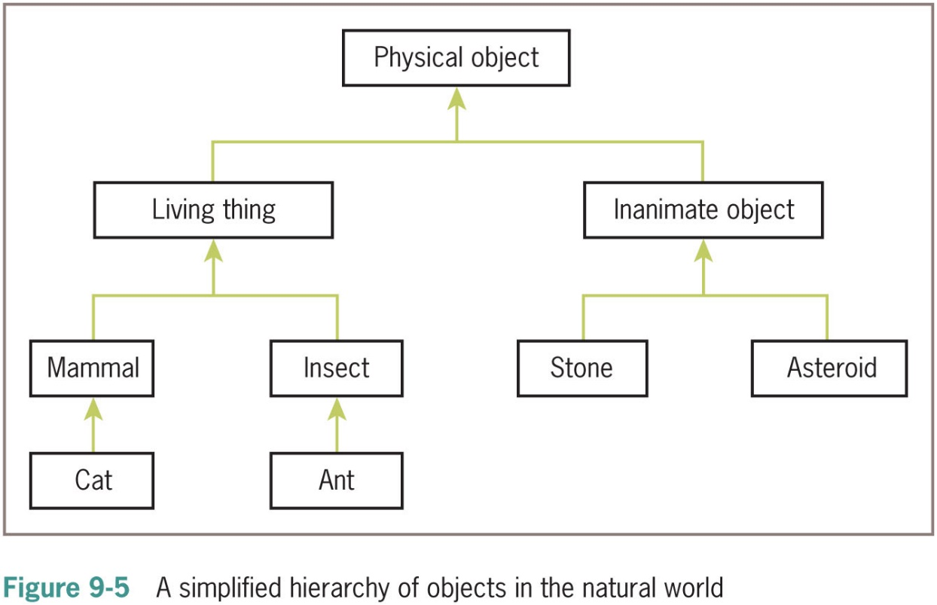
Inheritance Hierarchies and Modeling (1 of 2)

Slide 33
Inheritance Hierarchies and Modeling (2 of 2)
In Python, all classes automatically extend the built-in object class (It is the parent of all.
It is possible to extend any existing class:
class <new class name>(<existing parent class name>):
Example:
PhysicalObject would extend object
LivingThing would extend PhysicalObject
Inheritance hierarchies provide an abstraction mechanism that allows the programmer to avoid reinventing the wheel or writing redundant code

Slide 34
Example 1: A Restricted Savings Account
"""
File: restrictedsavingsaccount.py
This module defines the RestrictedSavingsAccount class.
"""
from savingsaccount import SavingsAccount
class RestrictedSavingsAccount(SavingsAccount):
"""This class represents a restricted savings account."""
MAX_WITHDRAWALS = 3
def __init__(self, name, pin, balance = 0.0):
"""Same attributes as SavingsAccount, but with
a counter for withdrawals."""
SavingsAccount.__init__(self, name, pin, balance)
self.counter = 0
def withdraw(self, amount):
"""Restricts number of withdrawals to MAX_WITHDRAWALS."""
if self.counter == RestrictedSavingsAccount.MAX_WITHDRAWALS:
return "No more withdrawals this month"
else:
message = SavingsAccount.withdraw(self, amount)
if message == None:
self.counter += 1
return message
def resetCounter(self):
"""Resets the counter to 0."""
self.counter = 0

Slide 35
Example 1: A Restricted Savings Account
>>> account = RestrictedSavingsAccount("Ken", "1001", 500.00)
>>> print(account)
Name: Ken
PIN: 1001
Balance: 500.0
>>> account.getBalance()
500.0
>>> for count in range(3):
account.withdraw(100)
>>> account.withdraw(50)
‘No more withdrawals this month’
>>> account.resetCounter()
>>> account.withdraw(50)
To call a method in the parent class from within a method with the same name in a subclass:
<parent class name>.<method name>(self, <other arguments>)

Slide 36
Polymorphic Methods
We create a subclass (child class) when two classes share a substantial amount of abstract behavior
The classes have similar sets of methods/operations
A subclass usually adds something extra
The two classes may have the same interface
One or more methods in subclass override the definitions of the same methods in the superclass to provide specialized versions of the abstract behavior
Polymorphic methods (e.g., the __str__ method)

